Slide 1
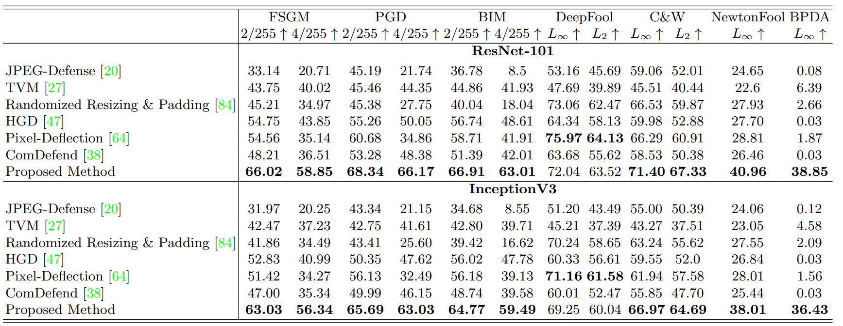
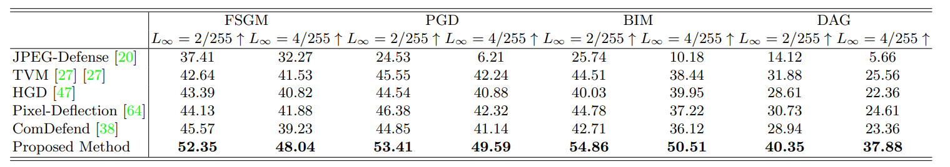
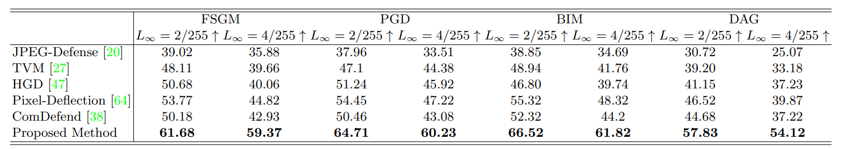
Quantitative Result on ImageNet Dataset
Quantitative Result on COCO Dataset
Quantitative Result on Pascal VOC Dataset

